Slide 1
Words on a page
Question-Answer Assignment
Leah Libke

Slide 2
The Themes
There is many different themes in this story. One is courage. Lenore shows courage when she has to ask her dad to go on the trip to Thunder Bay to read her story. She is nervous to ask because she thinks that he is going to say no, but she asks anyway.
Another one is don’t judge a book by its cover. Lenore's dad Pete, doesn’t know how to read so his isn’t reading her story, but everyone thinks that he is just being stubborn and doesn’t want his daughter to leave. Pete has a reason why he wont read the story, but people don’t see that.

Slide 3
the setting
The story is set in Spirit Bay, BC. Also at one point in the story they go to Thunder Bay, ON. If the place was changed/altered it would be a very different story. If it was moved to a place that didn’t have many First Nation, then the story wouldn’t be as relevant to the people that are listening to the story. Example if the story was based in Nova Scotia, then the story would be based on people that lived there and it wouldn’t have the more traditional stories involved.
The time frame of this story is modern day. If it was set in a different time it would be very different story. If the story was set in the 1920’s they wouldn’t have the reading competitions so then the story wouldn’t be created. It would make no sense because the whole story is based around wanting to go to Thunder Bay to read the story for the competition.

Slide 4
About Lenore
Lenore is a teenage, Ojibway girl. She lives in Spirit Bay, BC. Lenore loves to read and write. She is very good at it too. Her family includes her father Pete, her mother Connie and her sister Sadie. She has a good relationship with her mother and sister. They seem to get along well. Her relationship with her dad is pretty good. A few times through the story it turns bad but its fairly good overall.

Slide 5
About Pete
Pete is Lenore’s dad. He is an Ojibway man. He makes canoes for a living and likes to hunt and fish. He likes thing to be right. Example: When Pete went to pick up his fishing nets, they didn’t have the floaters on them. He wasn’t vey happy because he then had to waste time sewing them on. Pete does not know how to read and that effects how he acts. Pete’s relationship with his family is a good one. He gets along with them most of the time. Sometimes Pete and Lenore disagree on things. Lenore and her teacher, Ms. Walker, have a great relationship. They get along and they really like each other.

Slide 6
About Connie
Connie is Lenore’s mother. She is a Ojibway lady. She is very calm and quiet. Connie says that you have to be patient and things may happen the way that you want them to. She really wants to see her daughter succeed. Connie wants Lenore to get the chance to go to university and follow her dreams. She has a good relationship with everyone in the story.

Slide 7
About Sadie
Sadie is Lenore’s younger sister. She really wants her sister to succeed. When Lenore finds out that her story has been selected to be read at Thunder Bay, Sadie can’t wait to tell her dad so she blurts out, “Dad, Lenore has something to tell you!” She has a fairly good relationship with everyone. Sometimes she can be a pain to Lenore.

Slide 8
About Ms. Walker
Ms. Walker is Lenore's English Teacher. She teaches at the local Spirit Bay school. Ms. Walker really wants to see Lenore succeed with her writing and reading. That is why she entered her story into the contest. She cannot see why Pete wouldn’t let Lenore go to Thunder Bay for the reading competition. Connie invites her over for supper so Ms. Walker talks to Pete about Lenore's writing. She really wants Lenore to take the opportunity that she has been offered.

Slide 9
The plot: Initial Problem
The main problem of this story is Lenore wants to go to Thunder Bay to read her story but her father Pete won’t let her. His reason why he won’t let her go is because he does not want Lenore to leave and not come back. Also Pete doesn’t know how to read so he can not read her story to see how good it is or what it is about.

Slide 10
Rising Action and complications
There are a few different rising actions and complications in this story.
The First one is Lenore really wants to go to Thunder Bay to read her story. Her dad Pete doesn’t want her to go. That makes Lenore really upset because she wants to go and wants her dad to be supportive of her.
Another one is when Lenore asks her dad to come to parent night. Pete has never gone to parent night before and still doesn't want to go. Lenore is supposed to be reading her story that night but backs out when she finds out that he isn’t coming.
The last one is Pete is not able to read. This causes problems because he is not able to read Lenore's story so she thinks that he is just ignoring her.

Slide 11
The climax moment
The climax moment is when Lenore is talking with her dad and she tells him about her dream. She tells him what the end result of the dream was. The birds all landed on the white snow and spelled the sentences from her story. Then after she is finished her talks with her for awhile, then says that she can go to Thunder Bay and that he will come with her.

Slide 12
Falling Action
The falling action is when they go to the university. Lenore reads her story to her dad before she reads to the whole crowd. He thinks it is wonderful and they are both happy.

Slide 13
The resolution
The resolution is when Lenore reads her story to the crowd and judges at the university. Then once she finishes everyone starts applauding, including her father.

Slide 14
Responding to the Story
I thought that the story was done very well. They really did a good job with the reading and the different voices for the characters. I thought that it ended well. They didn’t leave it as a cliff hanger. You got to hear that she read the story and her dad was happy for her.

Slide 15
Motivation Of Characters
Lenore really wanted to go to Thunder Bay to read the story so she needed to get her dad on board with her. That contributed to a couple of conflicts in the story.
Pete didn’t want his daughter to leave for university in Thunder Bay so he said that she couldn’t go. Also he was not able to read so he wasn’t able to read her story. Those reasons caused all the conflicts in the story.
Connie and Sadie really wanted to see Lenore succeed but Pete wasn’t helping her. That really didn’t add any conflict to the story.
Ms. Walker really wanted Lenore to go to Thunder Bay to read the story. When she finds out that it is Pete that is keeping her from doing so, she tries to talk to him to make him change his mind. She didn’t help the situation.

Slide 16
Benefits of the story
I think that everyone can benefit from this story. Some people could have a hard time connecting to it because they may have never been in a situation like that before. I think that everyone could find a good message in the story and they could learn from it.

Slide 17
Conflict
There was mostly external conflict in this story. It is mostly Lenore's dad that is keeping her from doing what she wanted to do. There was some internal conflict in there too. Lenore was having a hard time decided if she should tell her dad about Thunder Bay or not. Pete’s internal conflict is that he cant read. That stops him from reading Lenore’s story and then he doesn’t want her to leave to Thunder Bay.

Slide 18
Opinion Of the two women
Ms. Walker and Connie had a different opinion when Pete said that Lenore couldn’t go to Thunder Bay.
Ms. Walker was very upset when Pete said no. She really wanted Lenore to go. Ms. Walker even went to Lenore's house for supper and tried to convince Pete to let her go.
Connie also did want Lenore to go but she wasn’t forcing Pete to let her go. She just told Lenore to be patient and he will eventually let you go. Don’t bug to much, just let him think it over. That seemed to work out for Lenore because her eventually let her go.

Slide 19
Lenore’s and Pete’s Relationship
At the beginning, Lenore and Pete had a fairly good relationship. They were able to talk and have good conversations. Near the middle of the story Lenore isn’t very happy with her father. Pete will not let her go to Thunder Bay so she is a little annoyed. Near the end of the story Lenore and Pete's relationship has completely changed. They have a better understanding of each other. There relationship is really good now that she has read her story and her dad has heard it.

Slide 20
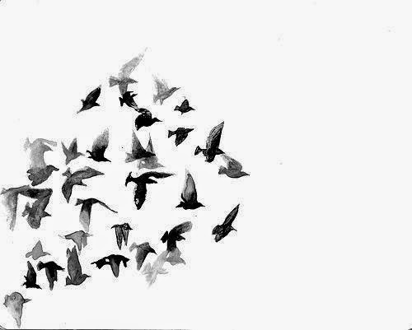
The bird dream
Lenore has a dream about birds that last quite a few nights. I think that the birds symbolize the words from her story. She says that the birds spell the sentences from her story. Also I think that the birds show First Nations in the world that is full of all other races.

Slide 21
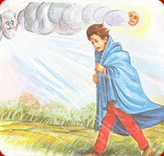
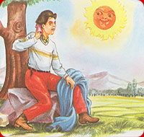
The sun and the wind
The story of the sun and the wind.
The sun and the wind were trying to see who was stronger. They did this by trying to get the man to take coat. The wind was up first. It tried and tried, blowing harder and harder. The man would still not take off his coat. The wind tried even harder but the man just tightened his coat.
Next up was the sun. he tried shining warm and bright. It made the man warmer and warmer until he was so warm that he took of his coat.
This story is a great way of showing when you are in a situation with conflict or someone wont let you do something. Don’t push to hard otherwise they will completely close the idea. If you let them have time to think, they may come around to the idea. An example is when Lenore wants to go to Thunder Bay but her dad wont let her, her mother say give him some time. He may come around to the idea.

